Slide 1
CLOUD BASICS

Slide 2
HOW CLOUD WORKS

Slide 3
Amazon
Infra
Google
Infra
Azure
Infra
Other SP
Internet
On Premises

Slide 4
CLOUD DATACENTER LOCATION

Slide 5
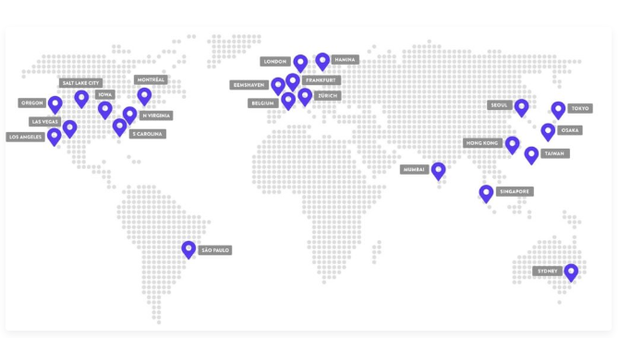
Google Cloud Data Center Locations

Slide 6
Google Cloud Data Center Locations (Continue)
Council Bluffs, Iowa, USA (us-central1)
St. Ghislain, Belgium (europe-west1)
Changhua County, Taiwan (asia-east1)
Sydney, Australia (australia-southeast1)
The Dalles, Oregon, USA (us-west1)
Salt Lake City, USA (us-west3)
Ashburn, Virginia, USA (us-east4)
Moncks Corner, South Carolina, USA (us-east1)
São Paulo, Brazil (southamerica-east1)
London, UK (europe-west2)
Frankfurt, Germany (europe-west3)
Jurong West, Singapore (asia-southeast1)
Tokyo, Japan (asia-northeast1)
Mumbai, India (asia-south1)
Montréal, Canada (northamerica-northeast1)
Eemshaven, Netherlands (europe-west4)
Hamina, Finland (europe-north1)
Los Angeles, California (us-west2)
Hong Kong (asia-east2)
Zürich, Switzerland (europe-west6)
Osaka, Japan (asia-northeast2)
Seoul, South Korea (asia-northeast3)
Las Vegas, Nevada, USA (us-west4)
Jakarta, Indonesia (asia-southeast2)

Slide 7
TYPES OF CLOUD SERVICE

Slide 8
Types of Cloud Computing
IaaS (Infrastructure as a Service), as the name suggests, provides you the computing infrastructure, virtual machines and other resources like virtual-machine disk image library, block and file-based storage, firewalls, load balancers, IP addresses, virtual local area networks etc. Examples: Amazon EC2, Windows Azure, Rackspace, Google Compute Engine.
PaaS (Platform as a Service), as the name suggests, provides you computing platforms which typically includes operating system, programming language execution environment, database, web server etc. Examples: AWS Elastic Beanstalk, Windows Azure, Heroku, Force.com, Google App Engine, Apache Stratos.
SaaS (Software as a Service) model you are provided with access to application software often referred to as "on-demand software". You don't have to worry about the installation, setup and running of the application. Service provider will do that for you. You just have to pay and use it through some client.

Slide 9
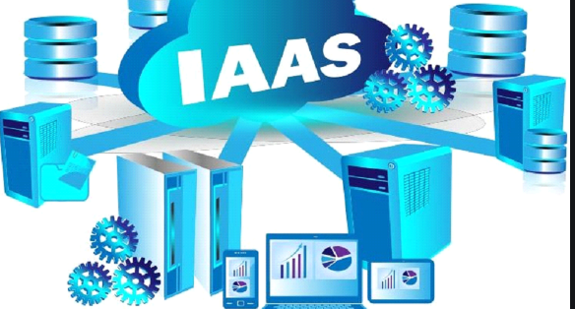
IAAS
Important Points
Server administration and management remains with Client.
Client responsible for Server patching, antivirus update, server backup, network configuration (VLAN), etc.
Internet
On Premises
(Client Side)

Slide 10

PAAS
Web Server Service
Programing Language Environment
Database Service
Important Points
Server administration and management remains with service provider.
Service provider responsible for Server patching, antivirus update, server backup, network configuration (VLAN), etc.
Internet
On Premises
(Client Side)

Slide 11
SAAS
Office 365
GitHub
Odyssey
Google Apps
Important Points
Server administration and management remains with service provider.
Service provider responsible for Server patching, antivirus update, server backup, network configuration (VLAN), etc.
Internet
On Premises
(Client Side)

Slide 12
CLOUD CONNECTION OPTIONS

Slide 13
Amazon
Infra
Google
Infra
Azure
Infra
Other SP
Internet
Connect via VPN
ExpressRoute
Hub & Spoke
On Premises
BRANCH 1
On Premises
BRANCH 2

Slide 14
Connecting an on-premises network (Azure)
VPN connection: A VPN gateway is a type of virtual network gateway that sends encrypted traffic between an Azure virtual network and an on-premises location. The encrypted traffic goes over the public Internet.
Azure ExpressRoute connection: ExpressRoute connections use a private, dedicated connection through a third-party connectivity provider. The private connection extends your on-premises network into Azure.
ExpressRoute with VPN failover: This options combines the previous two, using ExpressRoute in normal conditions, but failing over to a VPN connection if there is a loss of connectivity in the ExpressRoute circuit.
Hub-spoke network topology: A hub-spoke network topology is a way to isolate workloads while sharing services such as identity and security. The hub is a virtual network (VNet) in Azure that acts as a central point of connectivity to your on-premises network. The spokes are VNets that peer with the hub. Shared services are deployed in the hub, while individual workloads are deployed as spokes.

Slide 15
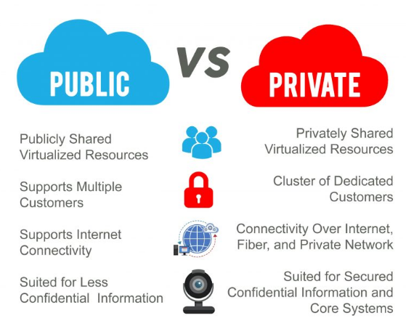
Types of Cloud Computing: Private, Public, and Hybrid Clouds
Hybrid cloud solutions are a blend of public and private clouds. This is a more complex cloud solution in that the organization must manage multiple platforms and determine where data is stored. An example of a hybrid cloud solution is an organization that wants to keep confidential information secured on their private cloud, but make more general, customer-facing content on a public cloud.

Slide 16
Reference
Choose a solution for connecting an on-premises network to Azure: https://docs.microsoft.com/en-us/azure/architecture/reference-architectures/hybrid-networking/
Types of Cloud Computing: Private, Public, and Hybrid Clouds: https://cloud.illinois.edu/types-of-cloud-computing-private-public-and-hybrid-clouds/
Where Are Your Google Cloud Data Center Locations?: https://kinsta.com/knowledgebase/google-cloud-data-center-locations/

